Slide 1
Data Types and Variables

Slide 2
2 types of data types
Primitive types
Reference types

Slide 3
Data Type | Range | Example
byte | -128 to 127 | byte b = 100;
short | -32,768 to 32,767 | short s = 25000;
int | -2,147,483,648 to 2,147,483,647 | int i = 500000;
long | -9,223,372,036,854,775,808 to 9,223,372,036,854,775,807 | long l = 10000000000L;
float | ~±3.4e38 (approx.) | float f = 12.5f;
double | ~±1.7e308 (approx.) | double d = 99.99;
char | 0 to 65,535 (Unicode values) | char c = 'A';
boolean | true or false | boolean flag = true;

Slide 4
Casting
2 types of casting - implicit and explicit
Be careful about overflow during explicit casting!
byte b1 = 130;
-128, -127,-126,………..0,1,3,...........126,127

Slide 5
Conditions: if-else-else if & switch case

Slide 6
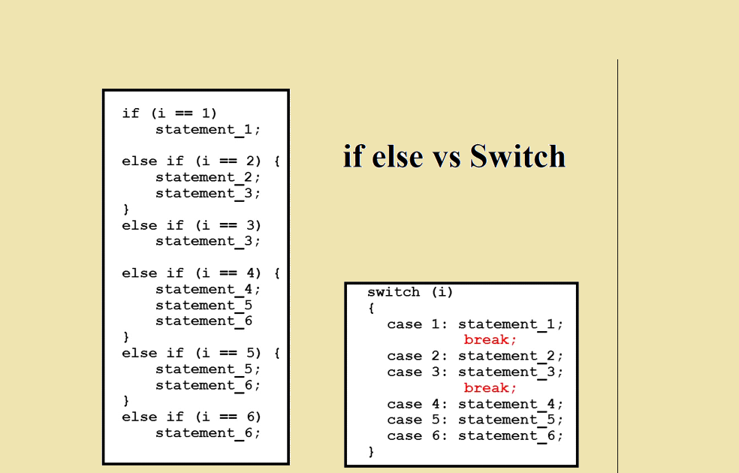
Which block of code to execute based on a given condition.
Unlike if-else where each condition is evaluated, in switch-case the execution jumps directly to the fulfilling condition.

Slide 7
Loops: For loop and While loop

Slide 8
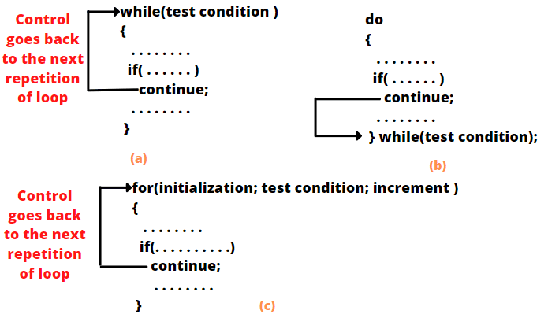
Executing the same piece of code for a given number of times

Slide 9
Arrays

Slide 10
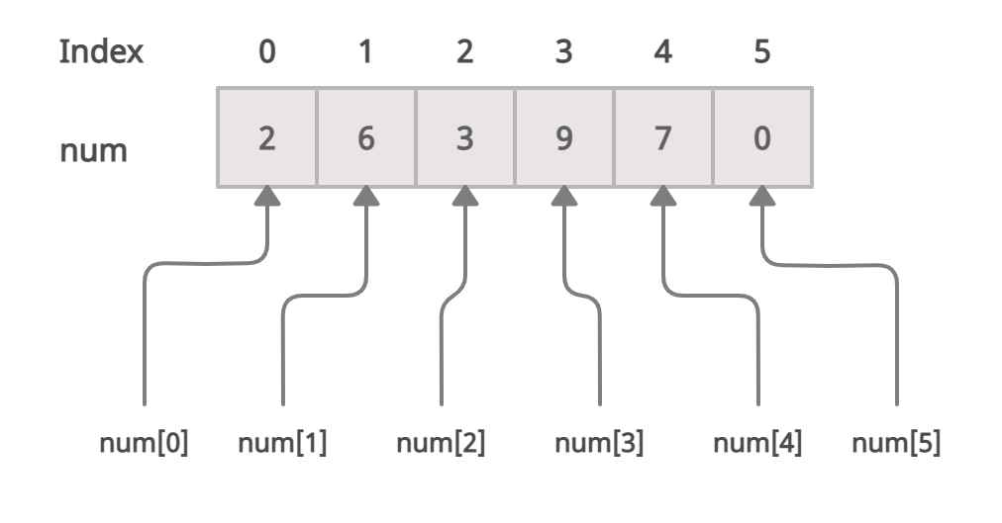
A structure storing data in continuous memory locations.
Arrays can be 1-dimensional or 2-dimensional.

Slide 11
Strings

Slide 12
String str = “This is a test string.”;
str.length() | Returns the number of characters in the string
str.contains(“Hello”) | Checks if the string contains a specific sequence
str1.equals(str2) | Compares two strings for exact match (case-sensitive)
str1.equalsIgnoreCase(str2) | Compares two strings for exact match (case-insensitive)
str.startsWith(“Hello”) str.endsWith(“World”) | Checks if the string starts or ends with a substring
str.toUpperCase() str.toLowerCase() | Converts all characters to lower or upper case
str.subString(0, 4) | Extracts a portion of the string .a .n .i .m .a .l .s 0 1 2 3 4 5 6
str.replace(“Hello”, “Bye”) | Replaces occurrences of a substring

Slide 13
Class and Object

Slide 14
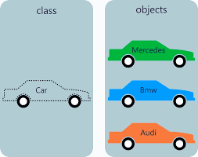
Class: A blueprint or template — defines properties (variables) and behaviors (methods).
Object: A real instance of that class — it has its own copy of those variables and can call the methods.

Slide 15
Car car1 = new Car();
car1.brand(“Toyota”);
color
color
Heap Memory
Stack Memory
new Car()
brand
speed
Car audi
new Car()
brand
speed
Car bmw

Slide 16
static keyword

Slide 17
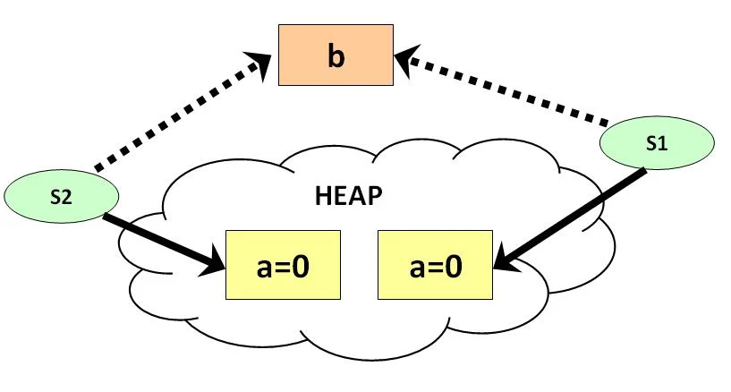
A keyword in Java that makes a variable or method belong to the class itself rather than to any specific object.
They are stored in a shared memory space.

Slide 18
Constructors and Methods

Slide 19
Constructor - helps to initialize an object
Method - defines the behavior of an object

Slide 20
Note:
Remember the different components of a Class.

Slide 21
Package and the import statement

Slide 22
Inheritance

Slide 23
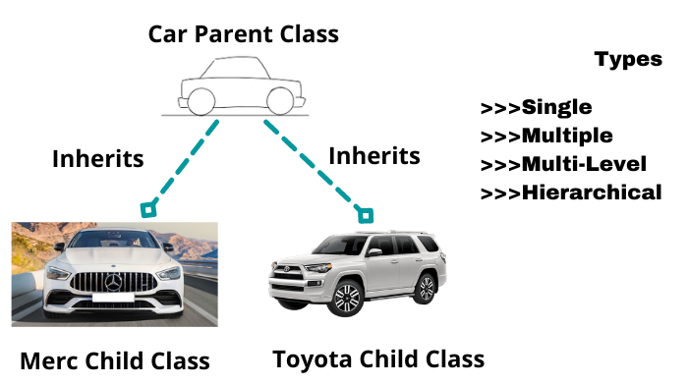
Inheritance in Java lets one class acquire the properties and behaviors of another class.
The parent class (also called superclass) defines common features.
The child class (or subclass) extends the parent, reusing or overriding its methods.
The extends keyword is what connects them.

Slide 24
Abstraction: Abstract Class and Interface

Slide 25
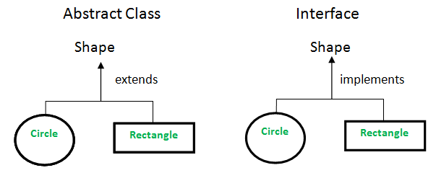
Abstract Class - may have zero or more abstract methods
Interface - will have all abstract methods
Abstract Method - A method without a body.

Slide 26
Encapsulaption: Access Types

Slide 27
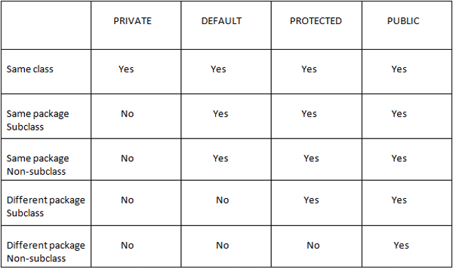

Slide 28
Polymorphism: Method Overloading and Method Overriding

Slide 29
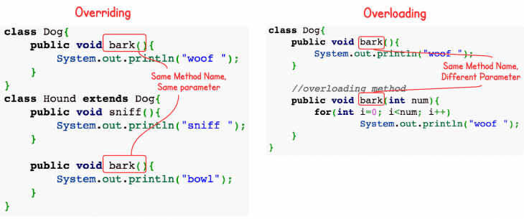
Polymorphism means the same method name can behave differently based on context — either within the same class or across parent and child classes.
Method Overloading:
  Two or more methods share the same name but differ in parameters.
  Both methods must be in same class.
Method Overriding:
  When a child class provides a new version of a method already defined in its parent.

Slide 30
Exception Handling

Slide 31
try block - Wraps code that may throw an exception and needs to be monitored for errors
catch block - Handles the exception thrown in the try block and defines the recovery logic.
finally block - Executes code always, whether an exception occurs or not, typically for cleanup tasks.
throws clause - Declares exceptions a method might throw, shifting handling responsibility to the caller.
throw statement - Explicitly throws an exception in code to signal an error condition or custom exception scenario.

Slide 32
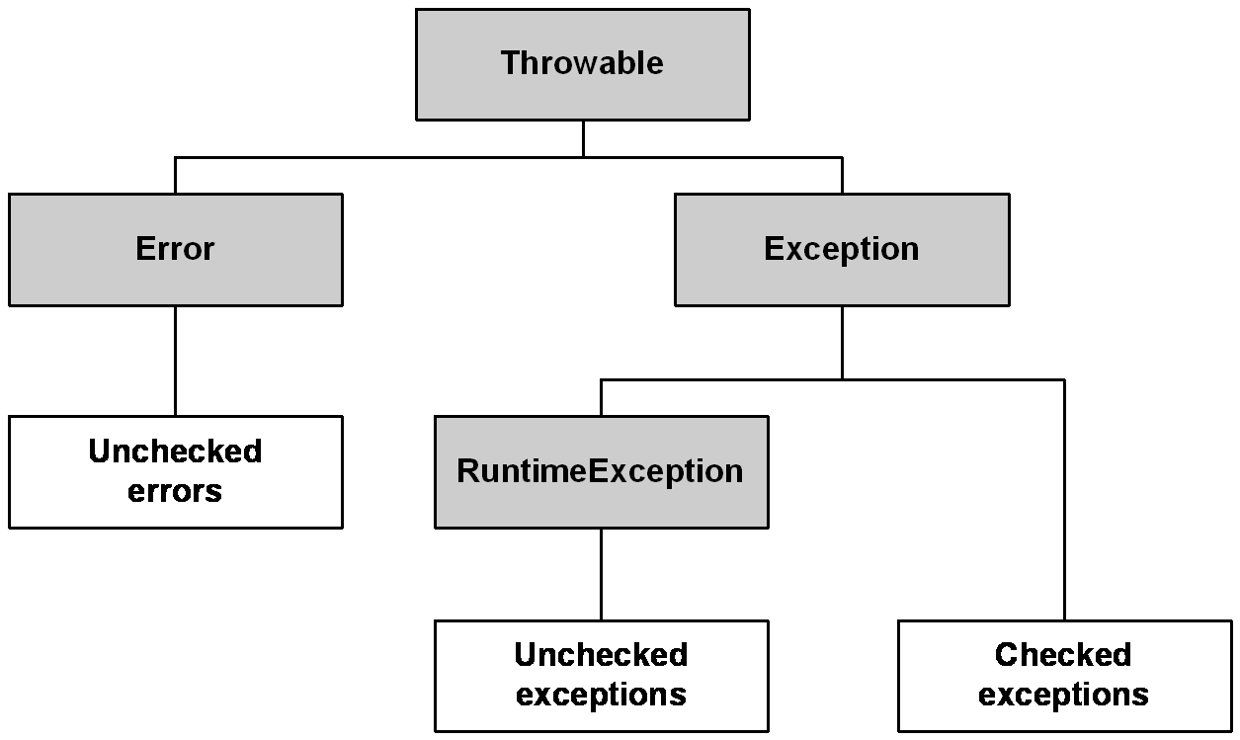

Slide 33
Checked Exceptions | Description
IOException | Error during input/output operations (e.g., reading a file)
FileNotFoundException | File not found during file handling
InterruptedException | Thread interruption occurred
Unchecked Exceptions | Description
ArithmeticException | Illegal arithmetic operation (e.g., divide by zero)
NullPointerException | Accessing object with a null reference
ArrayIndexOutOfBoundsException | Accessing invalid array index
NumberFormatException | Conversion of invalid string to number

Slide 34
Collection Framework

Slide 35
ArrayList
A dynamic array
Can store duplicate values
Values are stored in insertion order
HashSet
A dynamic array
Can store only unique values
Values are ordered using a hash function
HashMap
A collection of key-value pairs
Keys are unique but values can be duplicate
Values are ordered using a hash function

